Slide 1
Pricing Asian Options by Monte Carlo Methods
Math 477
Jovan Allen and Joseph Leong
March 31, 2017

Slide 2
Overview
Asian Options
Monte Carlo Methodology
Simulations and Findings
Discussion

Slide 3
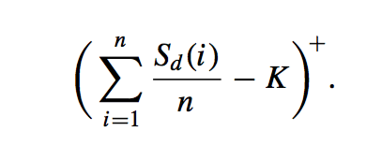
Asian Options
Type of Exotic Option
More complex than commonly traded options
Payoff determined by average underlying price over some period of time

Slide 4
Asian Options
Advantages:
Reduces risk of market manipulation
Less volatile than European options
Cheaper
Also Asian options where K is derived from average stock price

Slide 5
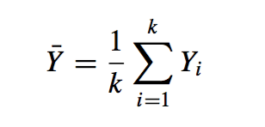

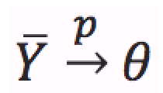
Monte Carlo Method
Statistical technique use to model probabilistic events
Idea:
Suppose we want to estimate the expected value, θ, of some random variable
If we can generate k iid random values (Y_{1,}Y_{2,}…,Y_{k}) we can estimate θ by
As ,, by Law of Large Numbers,

Slide 6


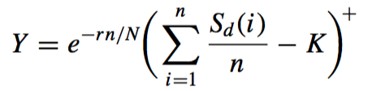
Monte Carlo Method
From Central Limit Theorem, as k gets large, should have an approximately Normal distribution
Applying to Asian Options:
Daily Share prices are generated using the Risk Neutral Geometric Brownian Motion Model
The simulated Asian Option present value of the payoff, Y, can be found by:

Slide 7

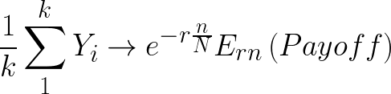
Monte Carlo Method
Repeating this method for k-1 more simulations, we get k simulated Asian Option payoffs:
Taking the average of the k values of Y yields the Monte Carlo estimate of the risk neutral valuation of the call:

Slide 8
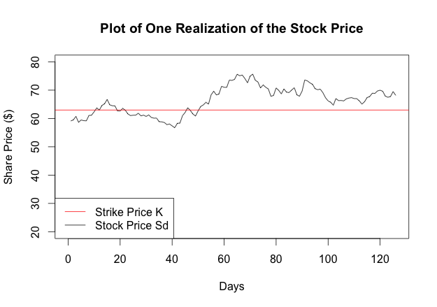
Simulations
Parameters used:
s=61, K=63, t=0.5, r=0.08, sigma=0.3
PV of Payoff
=
3.061335

Slide 9
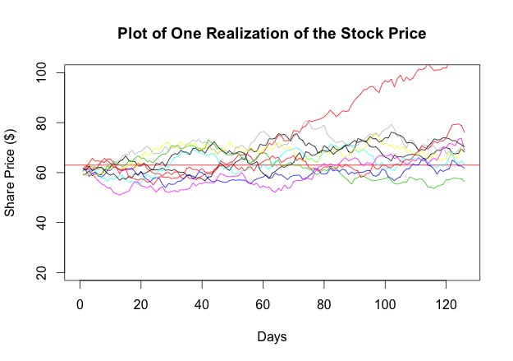
Simulations
Ten Simulated Realizations:
Pv of Payoffs =
3.0613349 13.2013260 0.0000000 0.0000000 0.9441357 0.0000000 4.5944380
7.6261382 3.9241529 0.3208530
Monte Carlo Estimate:
3.367238

Slide 10
Simulations
As we increase k, our Monte Carlo estimate converges to the true value
K=1,000,000 ran 10 times:
Value Variance
[1] 2.632722 20.175960
[1] 2.629572 20.107152
[1] 2.617941 19.956537
[1] 2.625505 20.098192
[1] 2.624909 20.016488
[1] 2.615629 19.977494
[1] 2.628922 20.132319
[1] 2.619424 20.036418
[1] 2.623533 20.027172
[1] 2.632191 20.116323
K=10,000,000 ran 10 times:
Value Variance
[1] 2.623967 20.082084
[1] 2.625328 20.081116
[1] 2.622219 20.046961
[1] 2.623188 20.043647
[1] 2.622652 20.065704
[1] 2.625139 20.087812
[1] 2.622739 20.044615
[1] 2.623389 20.073185
[1] 2.624379 20.077573
[1] 2.625775 20.083400

Slide 11
Findings
As the number of simulations increases, the accuracy of the Monte Carlo method increases
The risk neutral valuation of the Asian Option with the given parameters ≈ $2.62
European call with same parameter values has a valuation = $5.37
-Asian Option expected to be cheaper
-Approximately half, which is interesting (Average)

Slide 12
Extra
May be of interest to see how varying parameter values change the valuation of a Asian Option
Ran simulations varying one parameter value and holding the rest constant
K=10,000

Slide 13
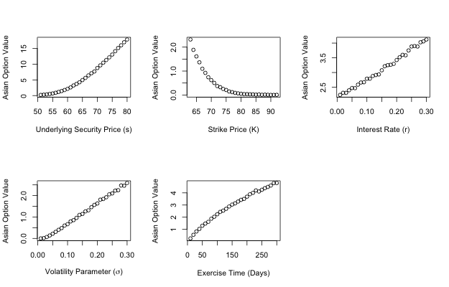
Extra

Slide 14

Discussion
Error:
-From simulations, k=10,000,000 appeared to be accurate to 1 cent
-To get accuracy to 0.1 cents:
-This implies the error decreases with the square root of k
-To decrease the error by a factor of 10, we need 100 times more points for the average

Slide 15
Discussion
Computing Issues:
- Large matrix of stock price realizations
-Slow
10 loops of K=10,000,000:
Resources: cput=01:26:11, ,mem=64564448kb

